Slide 1

UAS
SISTEM OPERASI
TIARA MERA SIFA
2341720247 – 1B

Slide 2

PENGERTIAN
SHELL
The Impact of Technology on Teaching and Learning
Teaching and Learning Before and After Technology
How to set up a virtual classroom
Virtual classroom adoption in the world
The Role of Interactive Technology in Learning
Benefits of Interactive Technology

Slide 3
How to set up a virtual classroom
Step 1
Step 2
Step 3
Step 4
Step 5
Pick a learning management system.
Review all online learning materials.
Invest in a calendar and comms app.
Select a secure live streaming platform.
Choose apps that foster collaboration.
Select one based on your unique needs
Ensure that ample information is provided
To facilitate seamless communication among educators and students
Choose one with a content delivery network
To empower students to get actively involved in their learning

Slide 4

Fitur 1
Lihat File
Teaching and Learning
With Technology
Learning was strictly through individual-based courses
Teacher-centered approach
Single mode of instruction
Collaborative learning is now possible
Student-centered approach
Differentiated instruction

Slide 5

Virtual classroom adoption in the world
As of January 2021
Learning sessions are now conducted online in 95% of schools in the world.

Slide 6

The Role of Interactive Technology in Learning
Interactive technology is reshaping learning
Interactive tech enables students to improve their ability to communicate both with their classmates and teachers.

Slide 7
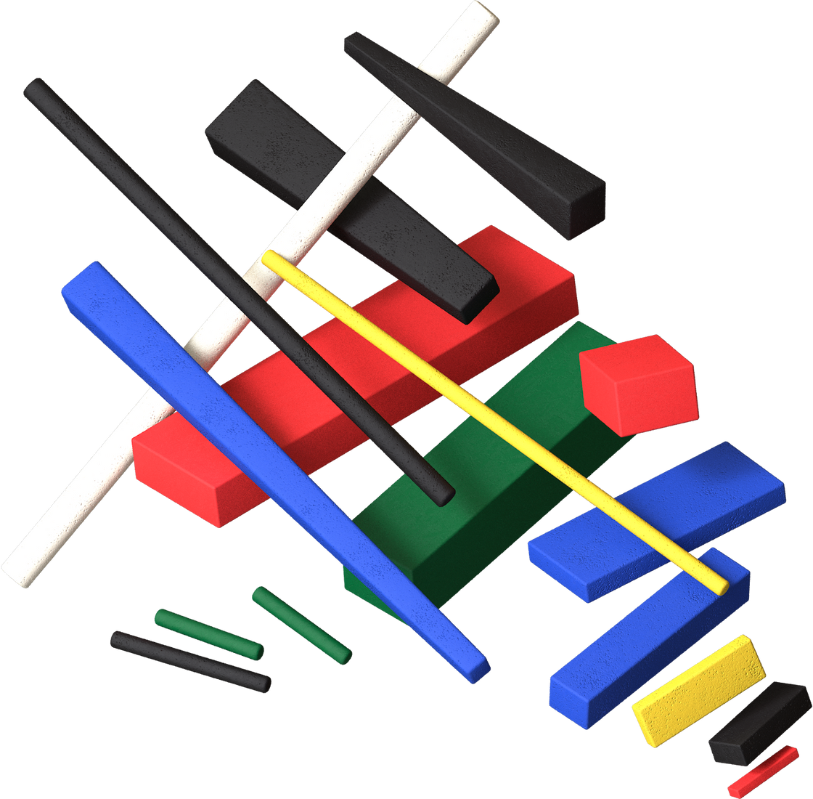
Benefits of Interactive Technology

Slide 8
Benefits on Teachers
Interactive tech empowers educators
Create lessons with mixed media
Faster feedback
Flexible teaching strategies
Educators can create lessons with mixed media and gamified elements
Teachers can offer instant feedback and guidance
Teachers are able to adapt to the learning styles of different students

Slide 9

Benefits
on Students
Enhanced engagement
Students can be more active in their learning thanks to quizzes, games, polls, video content, and other media.
How interactive tech transforms learning
Student-led learning
Everyone can learn at their own pace, helping students understand their strengths and weaknesses.
Fun, engaging lessons
Subjects that students usually deem boring can become more interesting.

Slide 10

Will remote learning be the new norm?
Remote learning is
here to stay.
Distance learning can be the new normal thanks to its convenience and ability to make lessons borderless and more engaging.

Slide 11

Technology and education now
go hand in hand.

Slide 12

What's Next in Digital Learning
1
Online classrooms mean digital learning
for everyone.
2
A global market for practical courses
and credentials
3
Improvement in the quality of blended learning
4
Rising demand for skills-based programs.
5
Greater investment on interactive technology
in solving the digital divide

Slide 13

Technology will never replace great teachers, but in the hands of great teachers, it’s transformational.
George Couros

Slide 14

Do you have any questions?
Send it to us! We hope you learned something new.

